Slide 1

PARKWHERE
SC2006 Software Engineering
Cirno Team

Slide 2
01
Expected Users

Slide 3
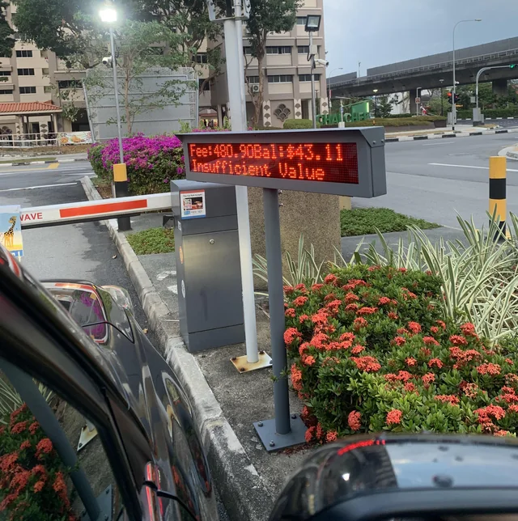
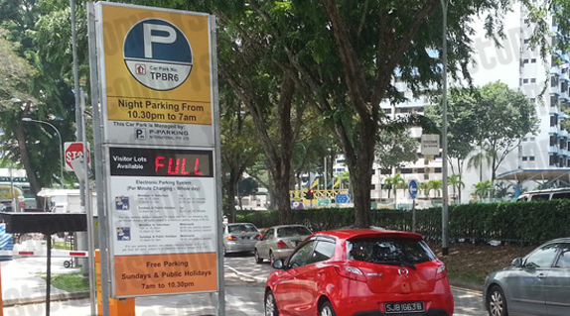


Expected Users

Slide 4
Expected Users
MOTORISTS
We aim to help
To quickly lookup on carpark information to find suitable car parks easily.

Slide 5
02
Main Functionalities

Slide 6



Main Functionalities
SEARCH
VIEW INFO
NAVIGATE
Users must be able to input a search query into the search bar which system will then process.
Users must be able to view various information about carparks such as availability and rates.
Users must be able to view selected carpark location on map and navigate to it.

Slide 7



Main Functionalities
FAVOURITES
BLACKLIST
Registered users must be able to add, edit and delete carparks to a favourites list.
Registered users must be able to add, edit and delete carparks to a blacklist.
Note that these != functional requirements and this list is not comprehensive. Specific details such as account settings are left out.

Slide 8
03
Use Case Diagram

Slide 9
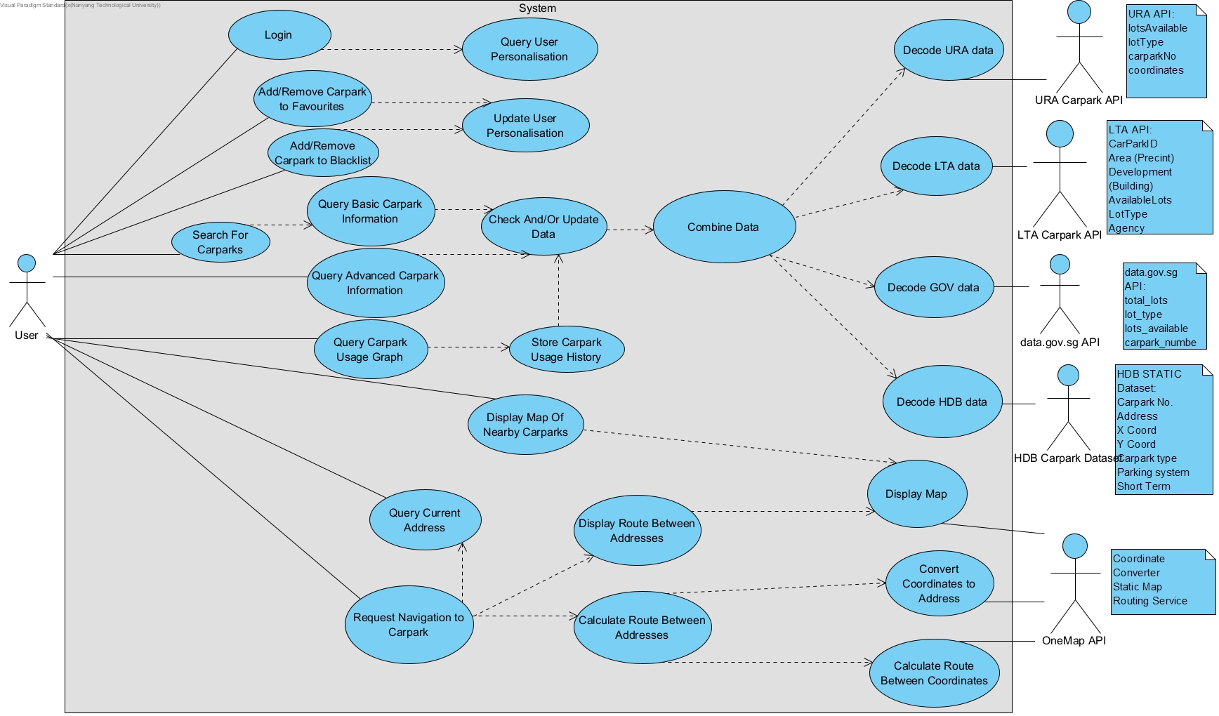
Notes:
Not done yet - Advanced Carpark Information, Query/Store Usage Graph, Display Map of Nearby Carparks

Slide 10
03
Highlighted Use Case

Slide 12
Highlighted Use Case
Search For Carparks
User enters search query into search bar
System parses search query into a resolvable location
System finds at most 10 (or other preset value) nearest carparks to the queried location
System displays at most 10 (or other preset value) nearest carparks to the queried location, with each carpark’s Basic Information, using the included use case Query Basic Carpark Information

Slide 13
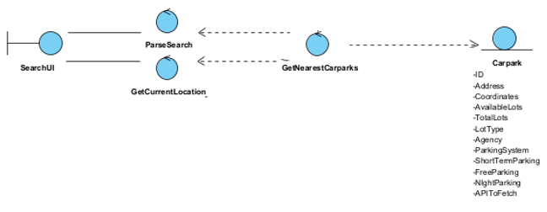
Boundary-Entity-Control UML Diagram

Slide 14
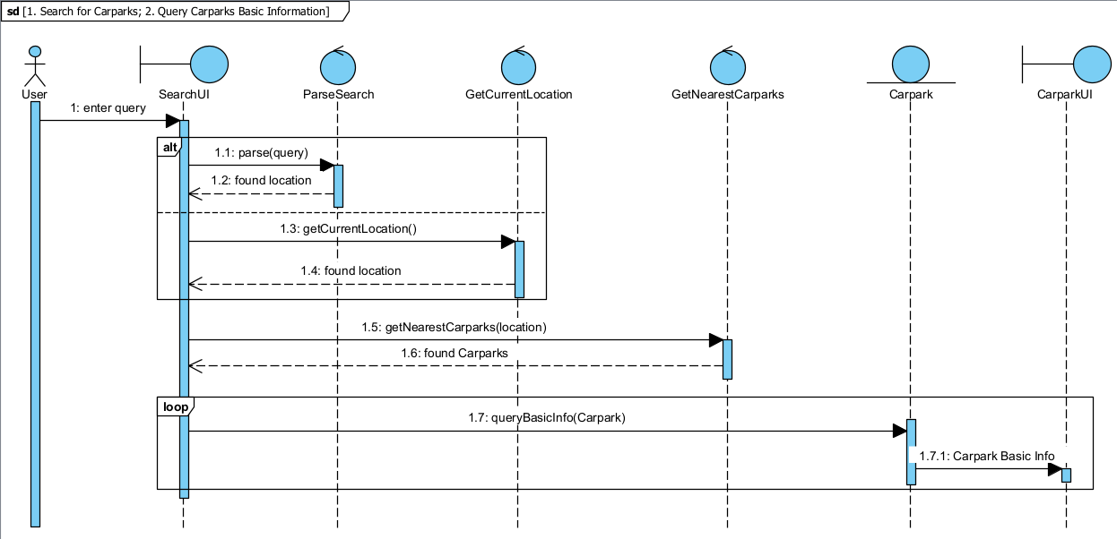
Sequence Diagram

Slide 15
03
Testing

Slide 16
Testing
Test Input | Input description | Expected Output | Actual Output
Singapore 099253 | Test for Postal Code checking | Carparks near Harbourfront e.g. VivoCity, Seah Im | Harbourfront Centre VivoCity P2 MARITIME SQUARE D OFF STREET VivoCity P3 SEAH IM ROAD OFF STREET
313 Somerset | Test for Partial address | Carparks near 313@Somerset i.e. Orchard | 313@Somerset Orchard Gateway Orchard Central Centrepoint The Heeren
Yishun Ave 9 | Test for Full address | Carparks along Yishun Ave 9 and nearby roads | BLK 317 YISHUN AVE 9 BLK 243/257 YISHUN RING ROAD/ AVENUE 9 BLK 315 YISHUN AVE 9 BLK 334 YISHUN ST 31 BLK 258/264 YISHUN STREET 22

Slide 17
04
Good Software Engineering Practices

Slide 18
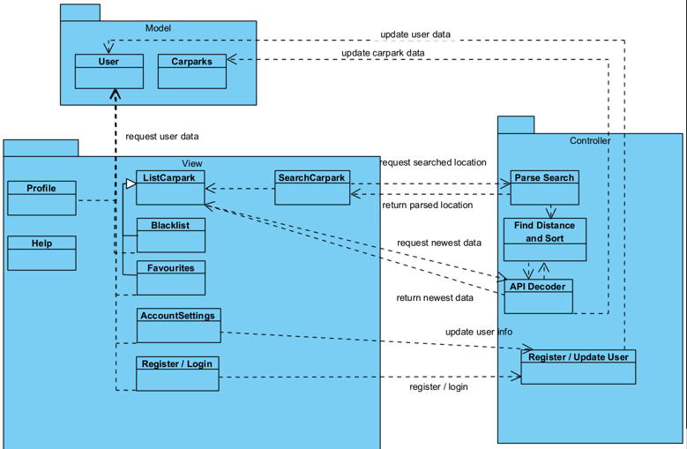
Good Software Engineering Practices
Model-View-Controller design benefits
Allows concurrent development - Front End (view & controller) and Back End (model) are separated
High modularity - views can be hot-swapped to change UI any time
Easily extensible - JSON data passed using REST, supports API extensions

Slide 19
05
Live Demo

Slide 20
Thank You!

